Slide 1
Classical Machine Learning
Unsupervised Learning
Week 4 - Day 2

Slide 2
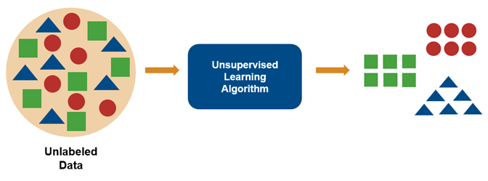
What is Unsupervised Learning?
Learning from unlabeled data.
The model identifies patterns, groups, or structures without explicit guidance.
Main Types:
Clustering: Grouping similar data points
Dimensionality Reduction: Reducing the number of features while preserving structure
Use Cases:
Anomaly detection, data compression

Slide 3
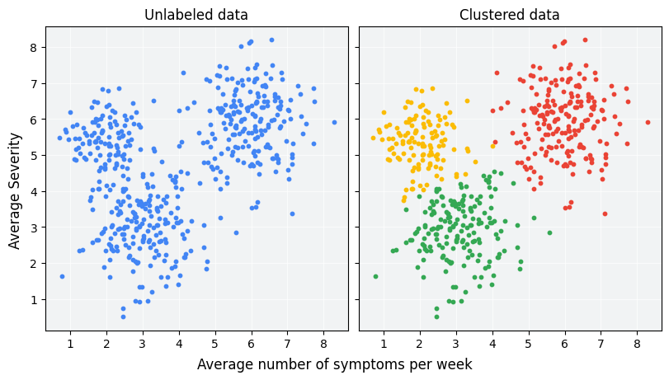
Clustering – Core Idea
What is Clustering?
Grouping data points so that points in the same cluster are more similar to each other than to points in other clusters.
Applications:
Customer segmentation
Document categorization
Image compression
Key Assumption: There is an inherent structure in data that can be revealed.

Slide 4
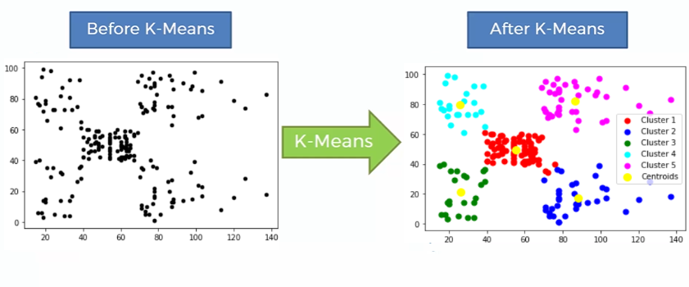
K-MEANS CLUSTERING
Concept:
Partition data into K clusters based on similarity.
Each cluster has a centroid (mean position).
Steps:
Choose K (number of clusters)
Initialize K centroids randomly
Assign each point to the nearest centroid
Update centroids (mean of points in each cluster)
Repeat until convergence

Slide 5
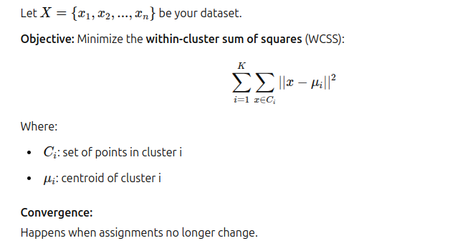
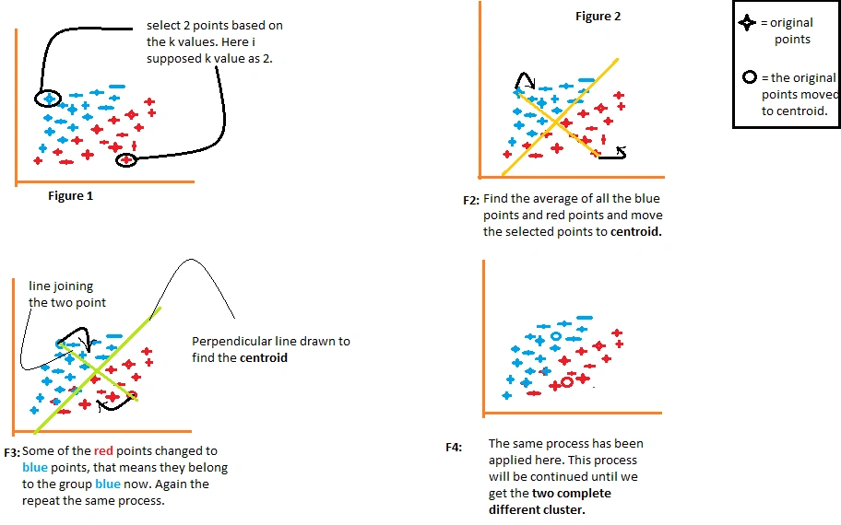
K-Means – Mathematical Steps

Slide 6
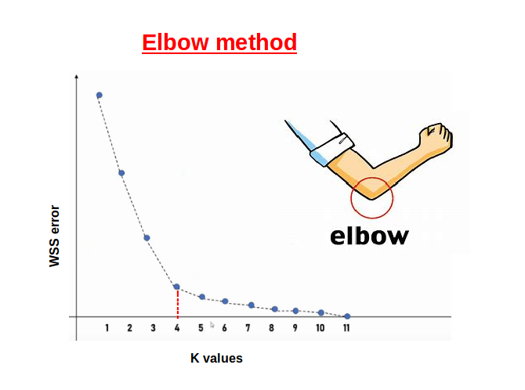
Choosing K – Elbow Method
Problem: How to choose the best number of clusters?
Elbow Method:
Run K-Means for multiple values of K (e.g., 1 to 10)
Plot K vs WCSS (Within-Cluster Sum of Squares)
Look for the "elbow point" – where WCSS decreases sharply and then levels off.

Slide 7
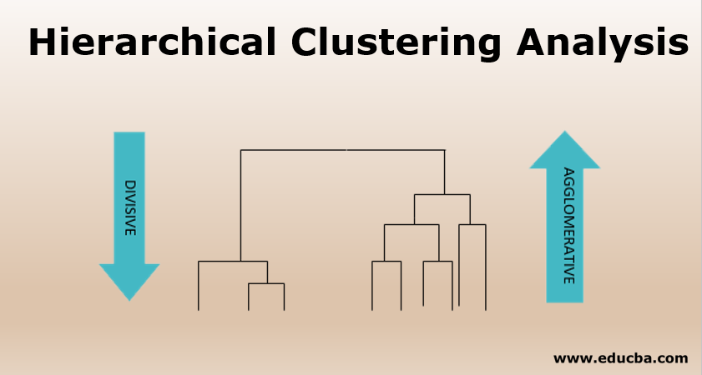
HIERARCHICAL CLUSTERING
Types:
Agglomerative (Bottom-Up) – Start with individual points, merge clusters
Divisive (Top-Down) – Start with one cluster, split recursively
Process (Agglomerative):
Compute distance matrix
Merge closest clusters
Repeat until one cluster remains
No need to specify K upfront!

Slide 8
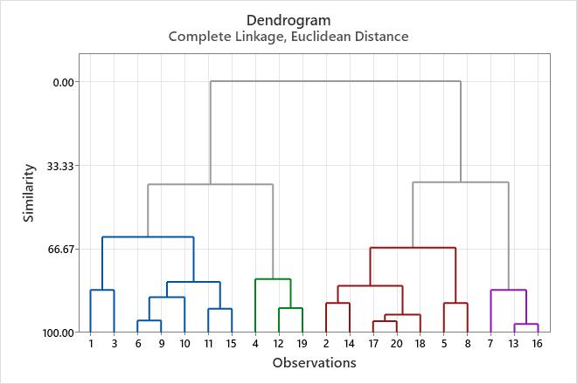
Dendrograms – Visualization
Dendrogram: A tree-like diagram showing merge/split decisions
Vertical axis: distance between clusters
Horizontal cut: defines number of clusters
Use to determine optimal K by cutting at largest vertical gap

Slide 9
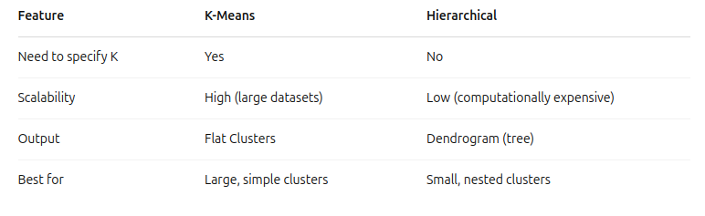
K-Means vs Hierarchical Clustering

Slide 10
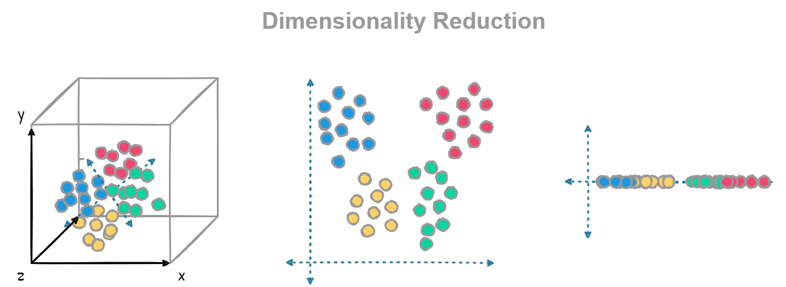
DIMENSIONALITY REDUCTION
What is Dimensionality Reduction?
Problem:
High-dimensional data → hard to visualize, slow to process
Some features may be redundant or noisy
Goal:
Reduce number of features while retaining important patterns
Benefits:
Improves visualization
Reduces computation
Removes noise

Slide 11
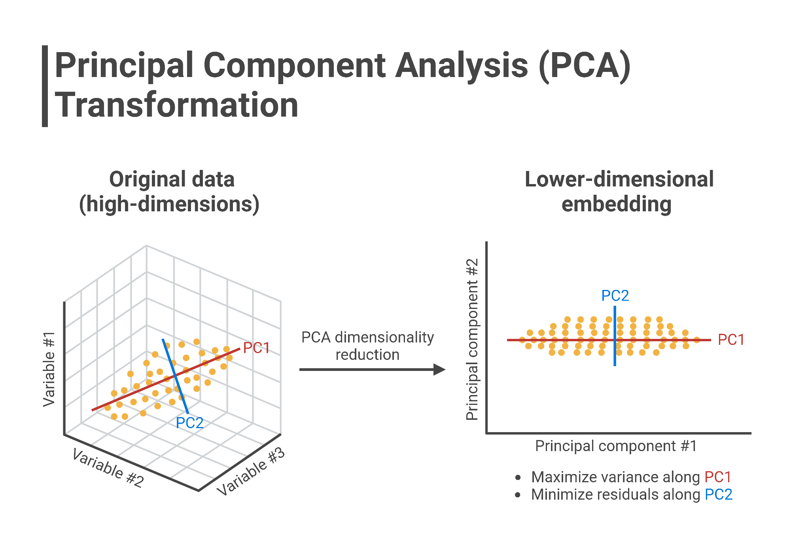
PCA – Principal Component Analysis
Goal: Find new axes (principal components) that maximize variance in data.
Concept:
Rotate the coordinate system to capture the most variation in fewer dimensions.
Steps:
Standardize data
Compute covariance matrix
Compute eigenvectors (directions) and eigenvalues (importance)
Project data onto top components

Slide 12
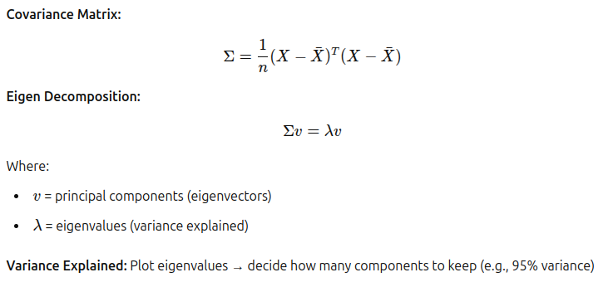
PCA – Mathematical Formulation

Slide 13
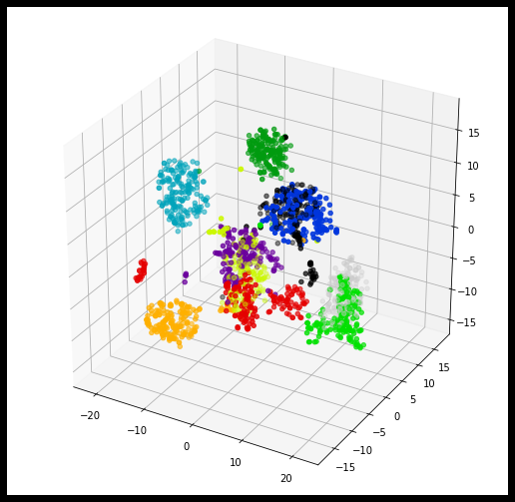
t-SNE – Visualization Tool
t-SNE (t-distributed Stochastic Neighbor Embedding):
Non-linear technique for visualizing high-dimensional data in 2D or 3D
Concept:
Preserves local structure (similar points stay close)
Not for training, just for visual insight
Use Cases:
Visualizing word embeddings
Understanding clusters in high-dimensional datasets
Caution: Sensitive to hyperparameters (perplexity, learning rate)

Slide 14
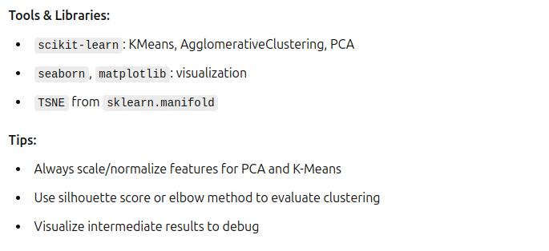
Unsupervised Learning in Practice

